Slide 1

Smart Urban Waste Management System for IoT Enabled Real Time Monitoring and Optimization
Team Details:
Names: ASHWIN T/ 211423104065 BHARATH RAJ M/ 211423104084
Batch Number: L8 Domain: Smart Waste Management
Guide Name & Designation Coordinator Name & Designation
V. ANITHA MOSES M.E(CSE) Dr.A.Hemlathadhevi , M.E., Ph.D.,
Date: 29-10-2025

Slide 2
Agenda
Introduction
Objective
Literature Survey
Problem Statement
System Architecture
Use Case & UML Diagrams
Modules
Methodology
Testing & Validation
Performance Analysis
Screenshots
Conclusion
Future Work
References

Slide 3
Introduction
Rapid urbanization increases waste generation
Inefficient waste collection causes overflow & pollution
Need for real-time monitoring and data-driven management
Integrates IoT, sensors, and machine learning
Supports smart city initiatives and sustainability

Slide 4
Objective
Monitor waste bins using IoT sensors and image data
Detect overflow and contamination in real-time
Optimize collection routes and frequency
Provide analytics for city administrators
Ensure cleaner and sustainable urban environment

Slide 5
Literature Survey
S.No | Author & Year | Method/Technique Used | Findings/Remarks
1 | Kumar et al., 2019 | IoT with ultrasonic sensors | Enabled real-time bin level detection
2 | Patel & Mehta, 2020 | GSM-based alert system | Automated waste collection alerts
3 | Reddy et al., 2020 | Image processing | Classified waste using image data
4 | Singh et al., 2021 | ML (SVM) | Improved waste type recognition
5 | Babu et al., 2021 | GIS-based mapping | Visualized waste locations spatially
6 | Sharma et al., 2022 | Deep learning (CNN) | Enhanced accuracy in waste detection
7 | Jain et al., 2022 | Smart bins + IoT | Monitored bin fill levels effectively

Slide 6
S.No | Author & Year | Method/Technique Used | Findings/Remarks
8 | Kaur et al., 2022 | Cloud-based IoT | Centralized data storage and alerts
9 | Rao et al., 2023 | Edge computing | Reduced latency in waste monitoring
10 | Ali et al., 2023 | PSO-KMeans | Improved clustering performance
11 | Hussain et al., 2023 | Drone-based imaging | Covered large city areas efficiently
12 | Thomas et al., 2023 | Spatial analytics | Identified high-risk waste zones
13 | Prasad et al., 2024 | Hybrid IoT-ML model | Increased prediction accuracy
14 | Arora et al., 2024 | Cloud GIS framework | Integrated real-time waste tracking
15 | Dinesh et al., 2024 | CNN + IoT | Achieved smart, adaptive collection

Slide 7

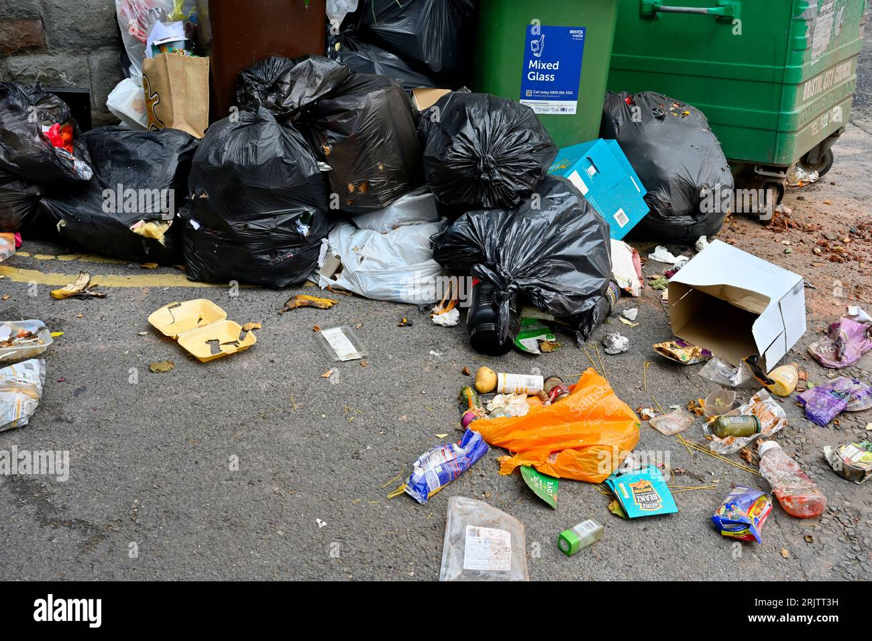
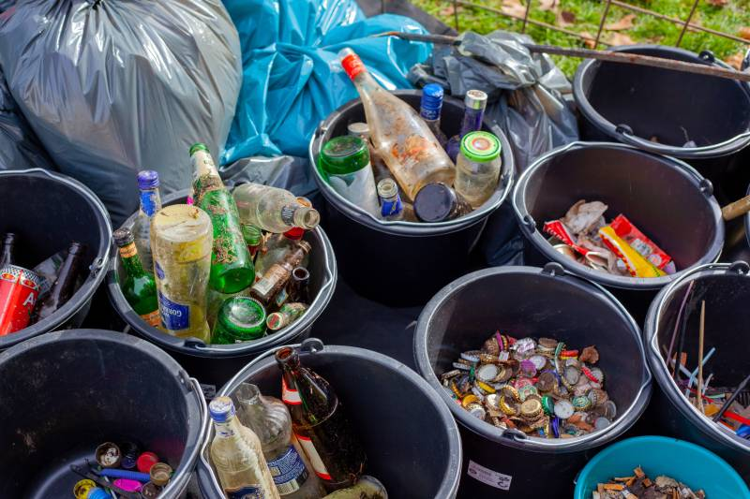
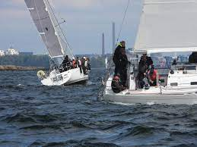
Problem Statement
Urban waste collection is still manual, causing delays, overflowing bins, and health hazards.
Lack of real-time bin status leads to inefficient pickup routes and missed collections.
Waste segregation at source is poor, affecting recycling and disposal processes.
Traditional systems are not optimized, resulting in high fuel usage and pollution.
There’s a need for an AI + IoT solution to monitor, classify, and manage waste efficiently.

Slide 8
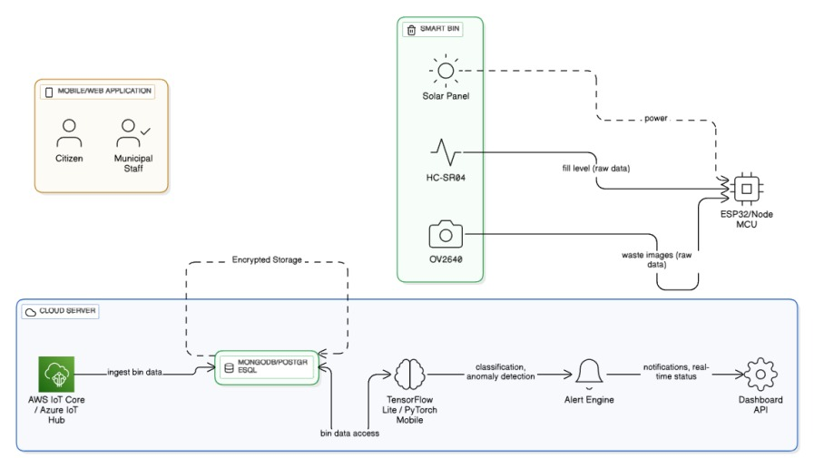
Product Architecture and Design/ Block Diagram

Slide 9
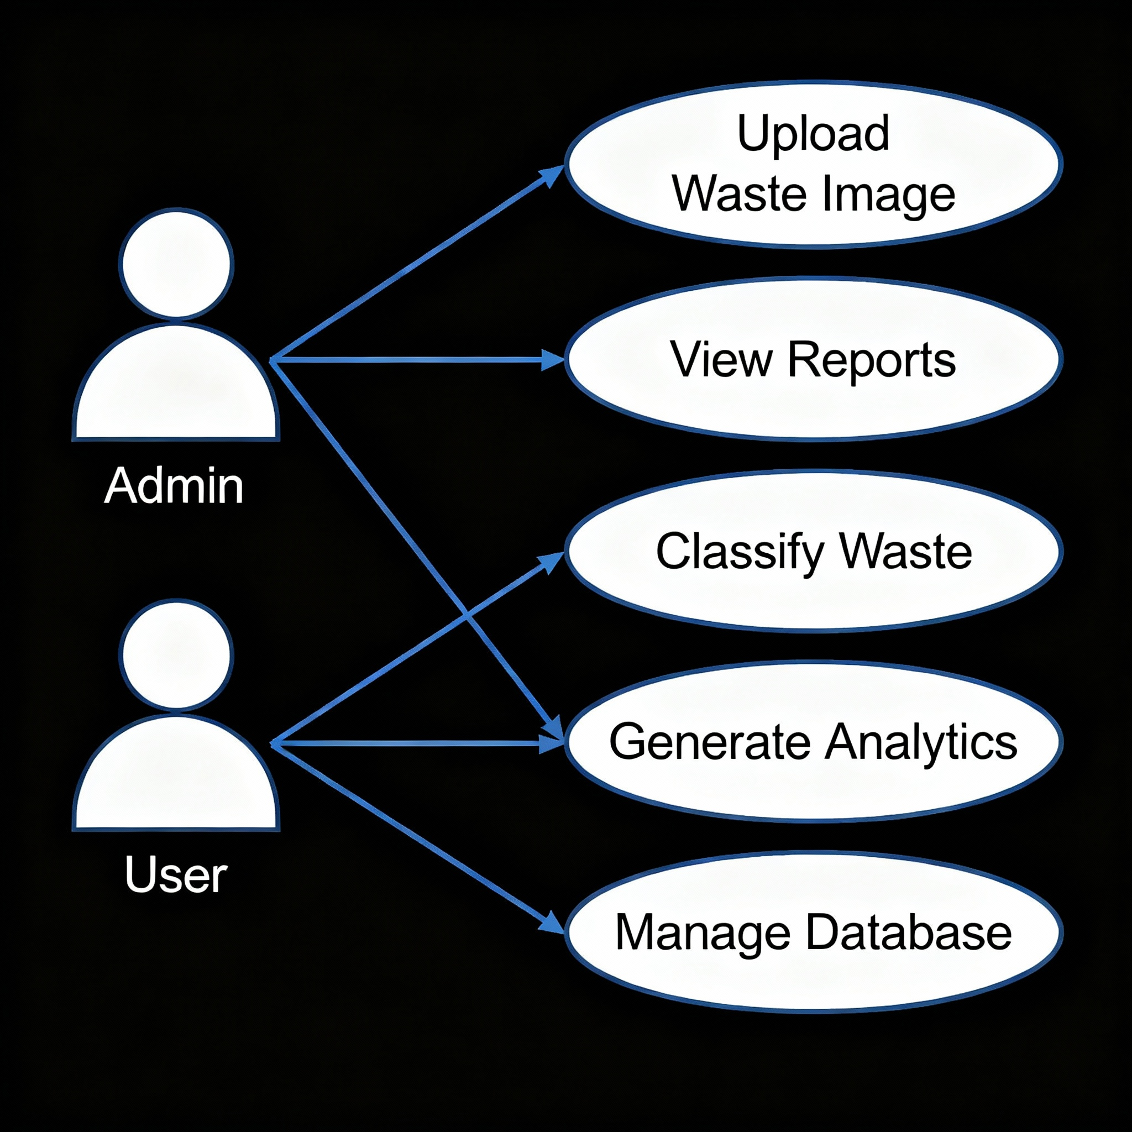
Use Case Diagram

Slide 10
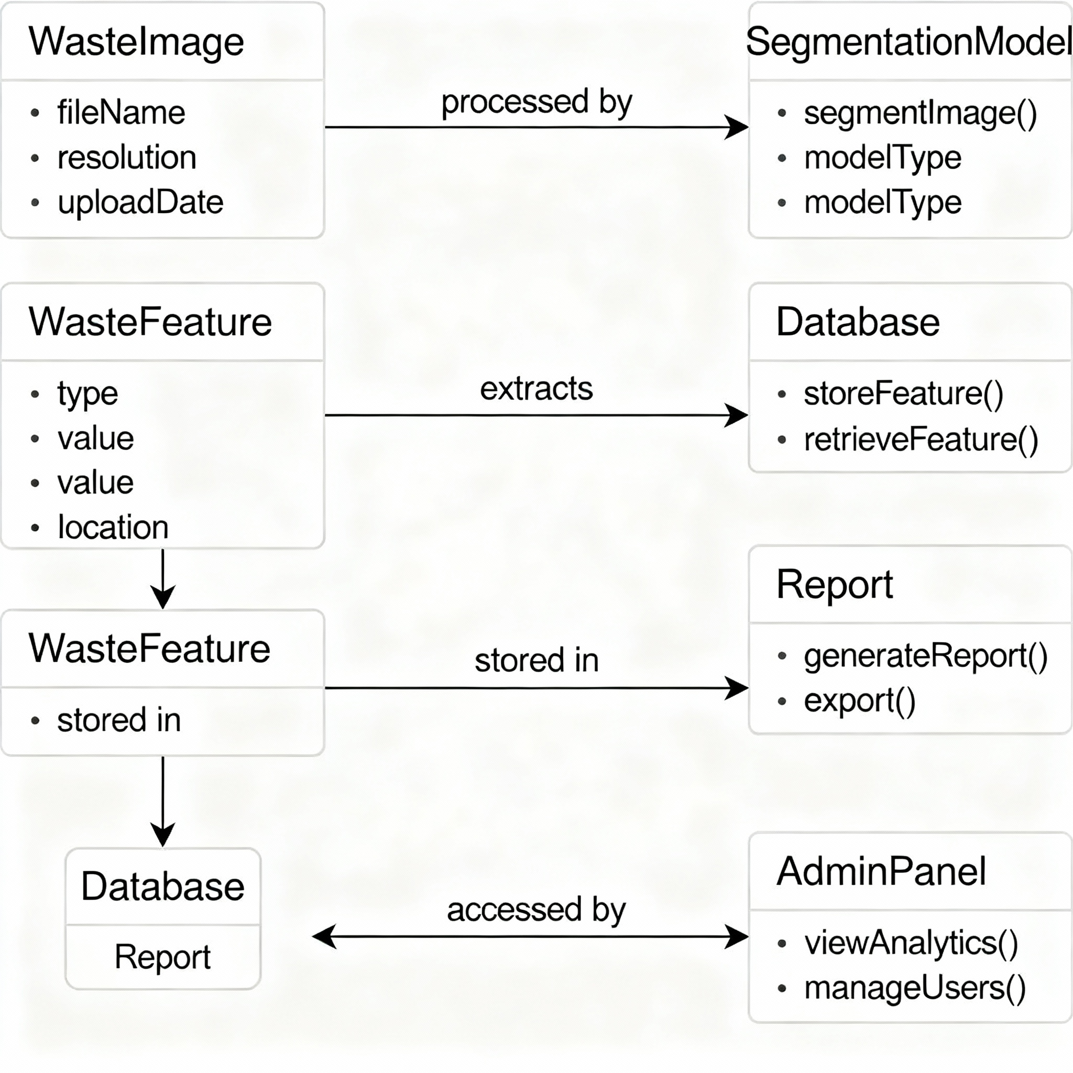
CLASS DIAGRAM

Slide 11
Modules
User Management: Authentication, profiles, roles.
Waste Tracking: Monitor different waste categories, data input.
Bin Monitoring: Detect bin status, send alerts.
Live Dashboard: Visualizes waste levels.
Analytics & Reports: Stats, trends, downloadable reports.
Pickup Scheduling: Manage and notify waste pickups.
Location Services: Find bins/recycling centres, geo-tagged reports.
Notifications: Alerts, reminders, tips.
Educational Guide: Waste sorting instructions.
Feedback & Issue Reporting: Submit feedback and problems.
Admin Panel: Manage users, bins, and analytics.

Slide 12
Algorithms / Methodology
Step 1: Capture waste images and sensor data
Step 2: Apply preprocessing (resizing, noise removal)
Step 3: Extract features using CNN
Step 4: Cluster bins using K-Means / PSO-KMeans
Step 5: Compute risk score for each bin
Step 6: Display result on dashboard (GeoJSON map)

Slide 13
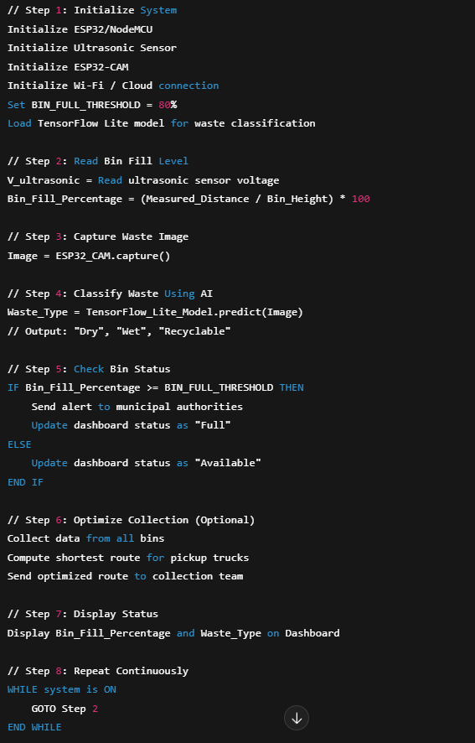

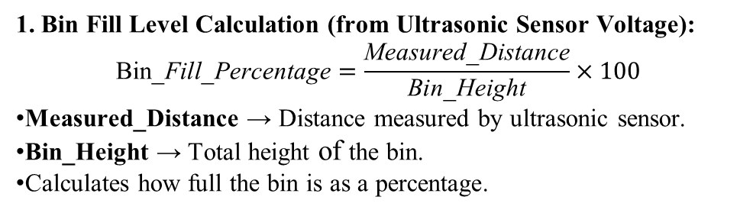
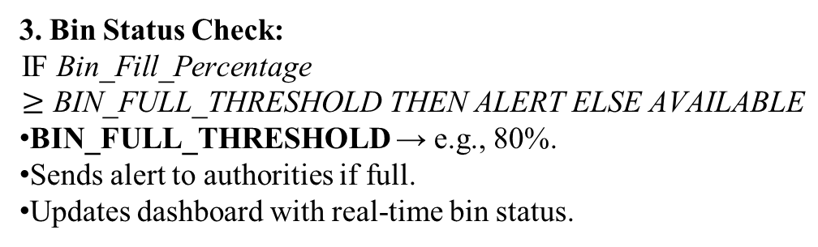
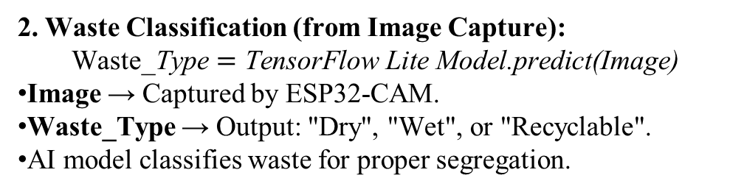
1. Bin Fill Level Calculation (from Ultrasonic Sensor Voltage):
$$\text{Bin}\text{_}\text{Fill}\text{_}\text{Percentage}=\frac{\text{Measured}\text{_}\text{Distance}}{\text{Bin}\text{_}\text{Height}}×100$$
Measured_Distance → Distance measured by ultrasonic sensor.
Bin_Height → Total height of the bin.
Calculates how full the bin is as a percentage.
2. Waste Classification (from Image Capture):
$$\text{Waste}\text{_}\text{Type}=\text{TensorFlow} \text{Lite} \text{Model}\text{.}\text{predict}\text{(}\text{Image}\text{)}$$
Image → Captured by ESP32-CAM.
Waste_Type → Output: "Dry", "Wet", or "Recyclable".
AI model classifies waste for proper segregation.
3. Bin Status Check:
$$\text{IF} \text{Bin}\text{_}\text{Fill}\text{_}\text{Percentage}≥\text{BIN}\text{_}\text{FULL}\text{_}\text{THRESHOLD} \text{THEN} \text{ALERT} \text{ELSE} \text{AVAILABLE}$$
BIN_FULL_THRESHOLD → e.g., 80%.
Sends alert to authorities if full.
Updates dashboard with real-time bin status.

Slide 14
Testing
Functional Testing – Checks module operations
Integration Testing – Ensures modules work together
Performance Testing – Checks response time and scalability
Validation Testing – Verifies outputs with expected results

Slide 15
Test Cases & Validation
Case 1: Bin full → Alert triggered successfully
Case 2: Bin empty → No alert
Case 3: Image blurred → Correct preprocessing
Case 4: Overflow detection → Accuracy above 90%
Case 5: Sensor error → Fallback handled properly

Slide 16
Performance Analysis
Accuracy: 92–95% (classification)
Latency: <2 seconds for detection
Scalability: Supports 100+ bins simultaneously
Energy Efficient: Low-cost IoT design
Real-time monitoring & quick alert generation

Slide 17
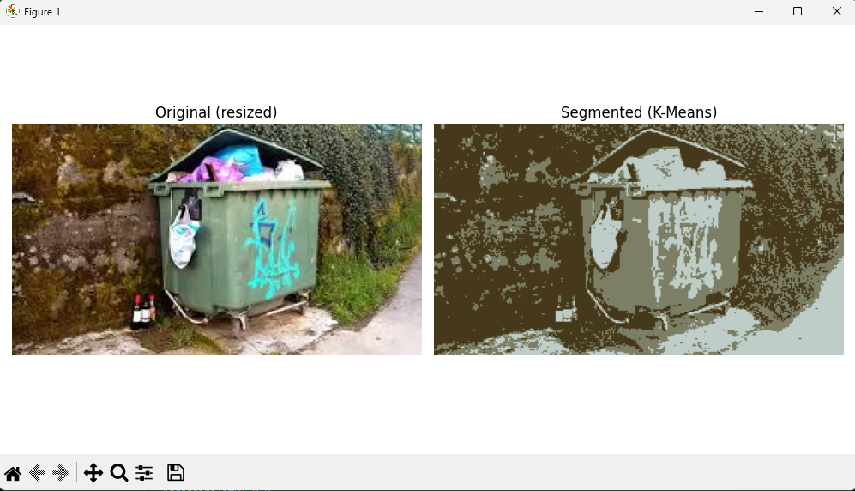
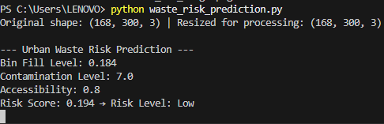
Screenshots
Sensor readings on terminal
Real-time bin detection output

Slide 18
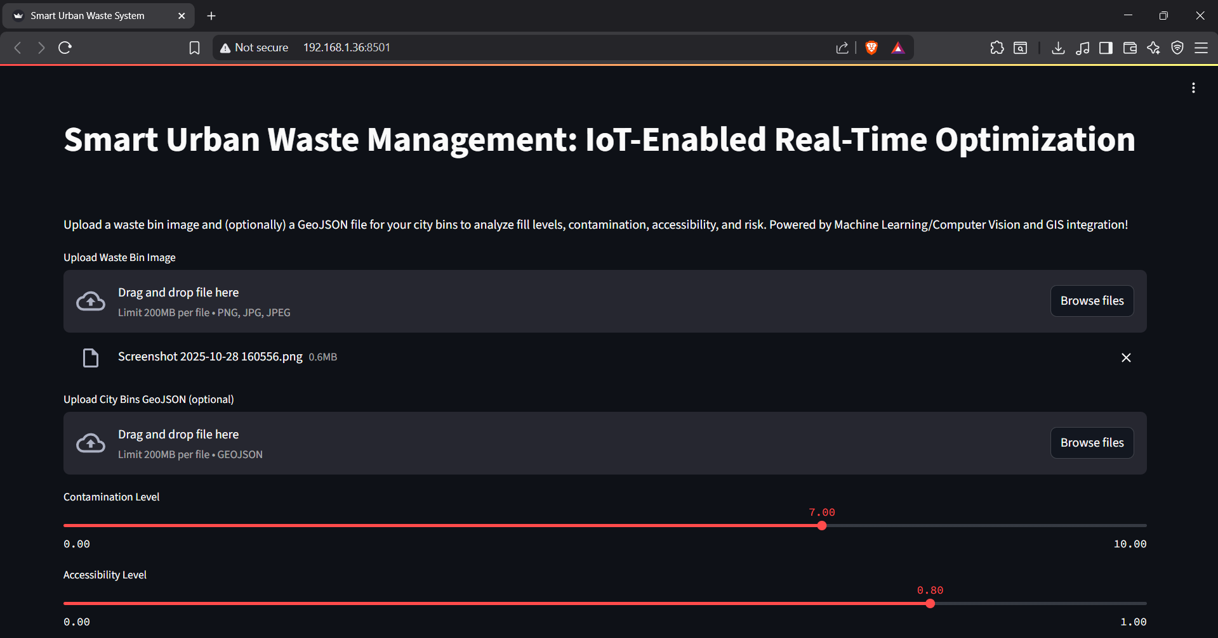
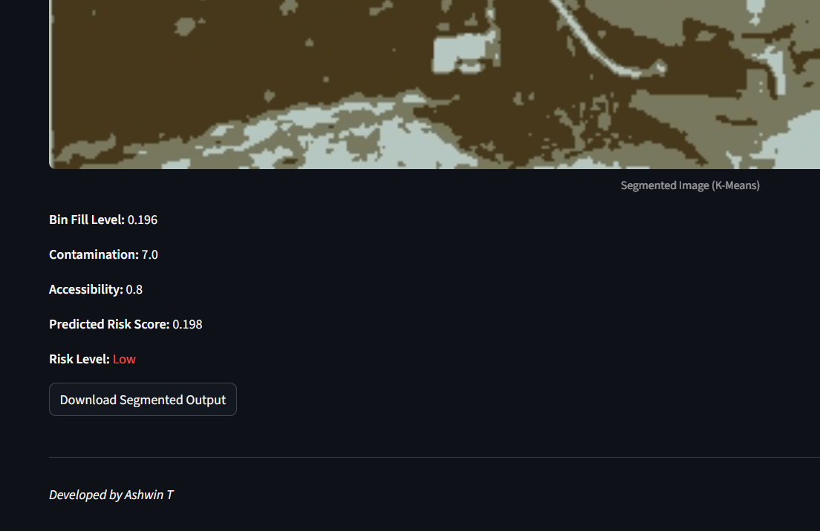
Waste Contamination Risk Visualization

Slide 19
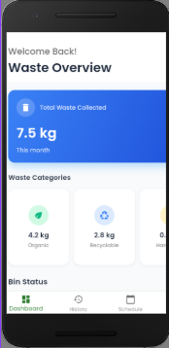
A simple Mobile Dashboard

Slide 20
Conclusion
Integrated ML, IoT, and GIS for waste monitoring
Reduced manual effort and improved accuracy
Enabled smart, data-driven waste management
Scalable, efficient, and sustainable framework

Slide 21
Future Work
Implement deep learning (U-Net, Mask R-CNN)
Add drone-based real-time monitoring
Improve accuracy with hybrid models
Integrate public reporting via mobile app
Expand to multi-city deployment

Slide 22
Integrate advanced edge computing for faster local data processing
Enable AI-based waste sorting with image recognition
Add predictive analytics for optimized collection schedules
Implement automated alerts for hazardous waste detection
Develop blockchain-based waste tracking for transparency
Introduce citizen engagement and reward programs
Support interoperability with other smart city systems

Slide 23
Reference
P. Fraternali, "Solid waste detection, monitoring and mapping in remote sensing applications," ScienceDirect, 2024.
S. Majchrowska, et al., "Deep learning-based waste detection in natural and urban environments," Journal of Image Processing, 2022.
S. R. Krishna, et al., "Cutting-edge image processing for precise solid waste classification," IEEE Transactions on Environmental Monitoring, 2024.
G. Ahmad, et al., "Intelligent waste sorting using convolutional neural networks (CNNs)," Nature Scientific Reports, 2025.
S. Chaturvedi, et al., "Machine learning integrated municipal solid waste production forecasting," Nature Environment and Pollution Technology, 2021.
AT&T Business, "Smart waste management with IoT technology," Tech Industry Report, 2023.
PhenomSG, "Computer vision based waste identifier project," GitHub Repository, 2023.
S. Chaturvedi, et al., "Predictive waste analytics using IoT and machine learning," International Journal of Environmental Sciences, 2025.
SBM Urban, "Application of geospatial tools in municipal waste management," GIS Urban Studies, 202X.
S. Sundaralingam, et al., "Deep learning-based approach to segregate solid waste in residential areas," Journal of Emerging Technologies, 2023.

Slide 24
Smarter Technologies, "Smart bin level monitoring solutions," Company Technical White Paper, 2023.
IJECC, "AI-powered cleanup: a revolution in solid waste management," International Journal of Environment and Climate Change, 2025.
A. P. Unnithan, et al., "Comparative study on waste detection using satellite imagery," Journal of Remote Sensing Applications, 2025.
IJERT, "Waste management by smart bin and app system using IoT," International Journal of Engineering Research & Technology, 2024.
JETIRGG, "Waste classification and detection using computer vision," Journal of Emerging Technologies and Innovative Research, 202X.
W. Xia, et al., "Application of machine learning algorithms in municipal solid waste management," Environmental Science & Technology, 2021.
Sgligis, "Smart waste management with GIS," Technical Report, 2024.
S. Sundaralingam, et al., "Deep learning based solid waste segregation," Environmental Engineering Journal, 2023.
Sensoneo, "Monitor fill levels of waste in bins using smart sensors," Product Documentation, 2025.
IT-JIM Blog, "Computer vision technology costs and considerations," Technical Blog, 2025.

Slide 25
Bridgera, "IoT based smart waste management system," Technology Paper, 2024.
Journal IJECC, "Enhancing municipal solid waste systems with machine learning," International Journal of Environment and Climate Change, 2025.
IJERT, "IoT based plastic waste management system," International Journal of Engineering Research & Technology, 2018.
SCALEA Code, "Waste management software development cost analysis," Technical Study, 2024.
Instructables, "Smart garbage monitoring system using Internet of Things (IoT)," Tech Publication, 2017.

Slide 26
Thank You

